Slide 1
Beta of Major AI Tech Stocks
Traders@SMU
Morgan Eun, Demetrios Lahiri, William Kroeger

Slide 2
Agenda
BETA OF AI TECH STOCKS
Research Hypothesis
Overview of Beta
Methodology
Gathering data
Calculating Beta
Risk Insights
Conclusions
Limitations and Challenges
References

Slide 3

Because of their historic risk, we believe that the volatility of AI tech stocks will make them optimal for short-term investment
Research Hypothesis:

Slide 4
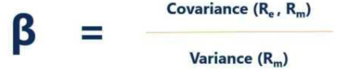

BETA – A Measurement of Risk
BETA OF AI TECH STOCKS
Basic Equation
Fundamental Concepts
Standard Deviation
Standardizes the measurement of the distance between points and a line of reference = measures volatility by calculating the average change in simple return over a certain period of time relative to the market (and standardizing it WITHOUT comparing to the actual market volatility
Variance vs. Covariance
Variance = the sum of the difference between market return and mean market return squared and averaged.
Covariance = the sum of the product between stock movement and market movement averaged.
Key Components
β = Beta coefficient
Sample Size = Number of trading days
R_{ABC}/A_{ABC} = Return on an individual stock/Average return on individual stock
R_{XYZ}/A_{XYZ} = Return on overall market/Average return on overall market (Nasdaq100)
Covariance = relationship between changes in stock and market returns looks at how the two variables are intertwined
Variance = distance of spread of market’s data points on average
Time Frame
252 trading days (market activity within 1 year)
Simple Average Return
We took simple average return instead of logarithmic returns

Slide 5
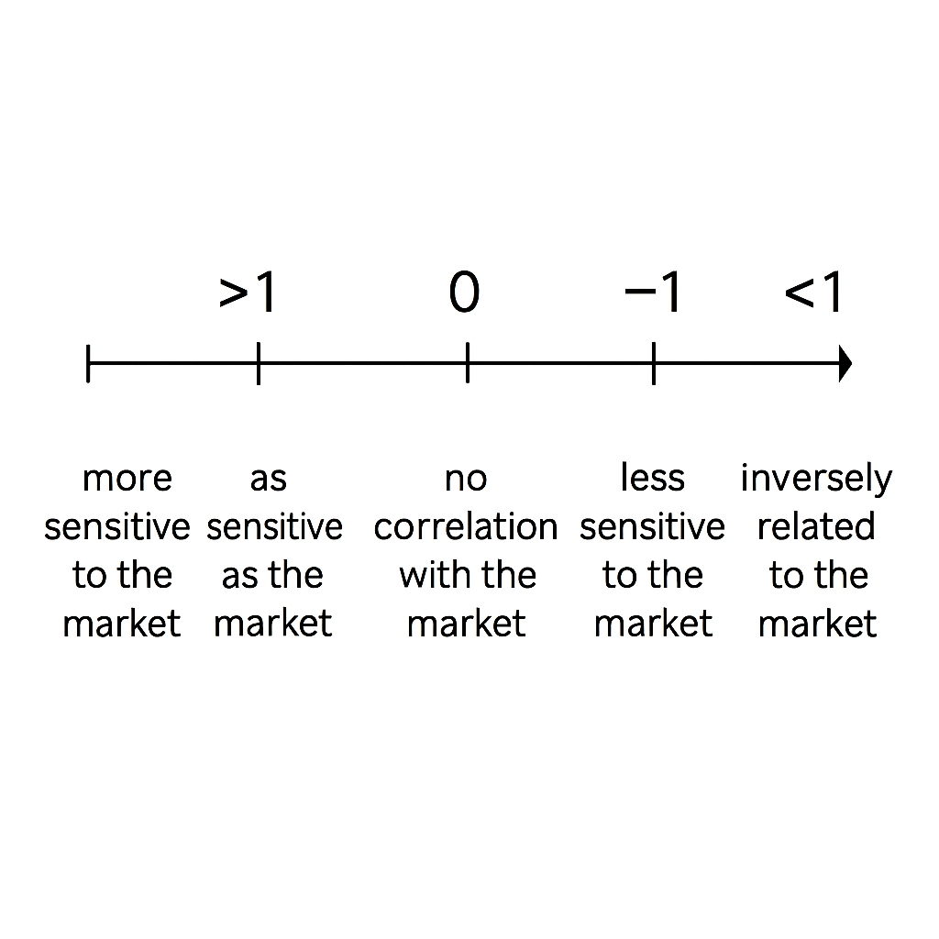
BETA – How to Read
BETA OF AI TECH STOCKS
> 1
1
< -1

Slide 6


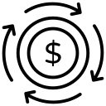








BETA – Applied to Major AI Tech Stocks
BETA OF AI TECH STOCKS
How its Used
Used in Future Predictions
Most AI tech stock betas exhibit a value between 1.5 to 2.5 (smaller firms may exhibit around 3 which are much higher price swings than the market average
Normally balanced out with other stocks within a portfolio with lower beta
Beta is often reassessed within your portfolio with new findings within the tech sector
Utilized in CAPM (Capital Asset Pricing Model) to estimate expected returns on a stock which compares stock beta to a return on risk-free (zero beta) asset, expected return on the market, and additional return from the market over the risk-free rate. Assuming alpha = 0
Normally balanced out with other stocks within a portfolio with lower beta
Beta itself cannot predict the future
Beta’s Limitations
Beta is a historic measurement and assumes that past relationships between a stock and the market will persist
Often change over time and are sensitive to the time frame (1 year vs 1 hour) especially for tech stocks
Captures systematic (market) risk, not company-specific or idiosyncratic risks

Slide 7
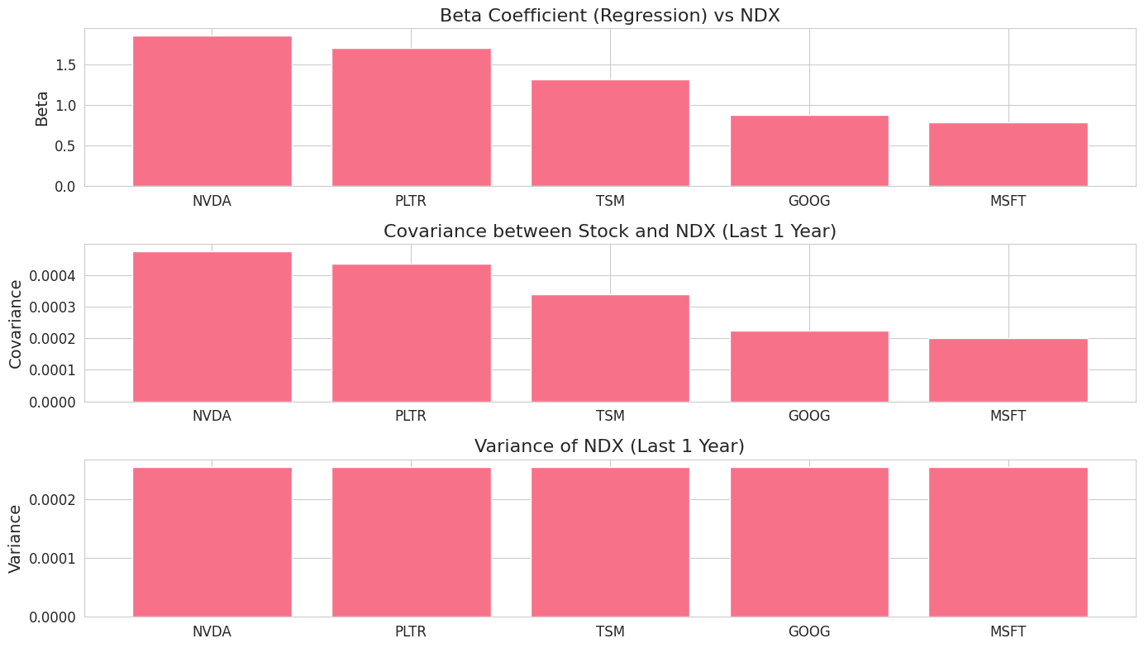
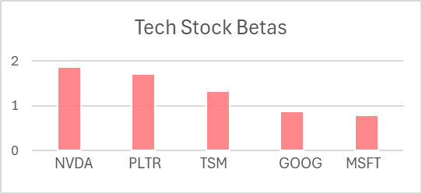
Beta Calculated Through Excel
BETA OF AI TECH STOCKS
Our Calculations
Nvidia (NVDA): 1.863
Palantir (PLTR): 1.710
Taiwan Semiconductor Manufacturing (TSM): 1.329
Google (GOOG): 0.882
Microsoft (MSFT): 0.788
Calculation Process
Found the simple returns for all the tech stocks.
Gather the simple returns for the index.
Calculate the variances or all the tech stocks, by utilizing the simple returns of the tech stocks.
Repeat but for the variance of the index through the utilization of the simple returns of the index.
Used the variance returns of the index, and the simple returns of the index to find the covariance.
utilized the covariance and the variance of the index to find the betas.
Notes:
https://onedrive.live.com/personal/21124c5c80d4aece/_layouts/15/Doc.aspx?sourcedoc=%7B7fb6f4d5-67c3-47f0-8742-50134b108d2a%7D&action=default&redeem=aHR0cHM6Ly8xZHJ2Lm1zL3gvYy8yMTEyNGM1YzgwZDRhZWNlL0VkWDB0bl9EWl9CSGgwSlFFMHNRalNvQlBrb1FGSHIyNzJ3QnMtVXUzTkhSVnc_ZT00OmozazdFUiZhdD05&slrid=566699a1-2009-8000-cd27-a4fbb5ef6cb7&originalPath=aHR0cHM6Ly8xZHJ2Lm1zL3gvYy8yMTEyNGM1YzgwZDRhZWNlL0VkWDB0bl9EWl9CSGgwSlFFMHNRalNvQlBrb1FGSHIyNzJ3QnMtVXUzTkhSVnc_cnRpbWU9V0NsSzQ0S0gzVWc&CID=95adbcab-fe34-4785-a9d4-339ffd9ca553&_SRM=0:G:40

Slide 8
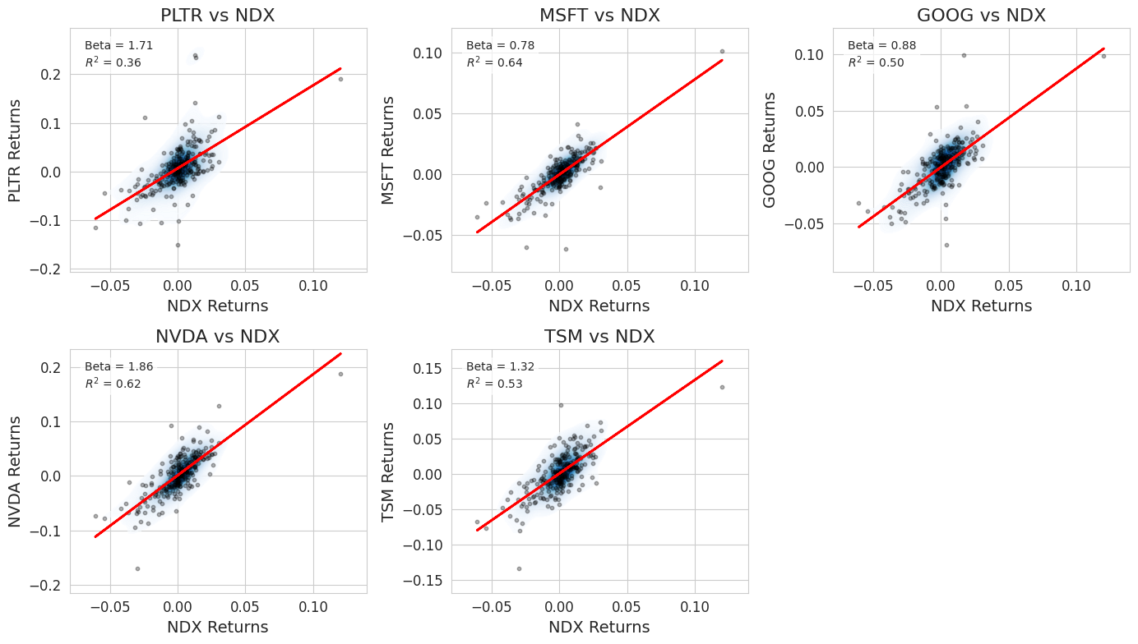
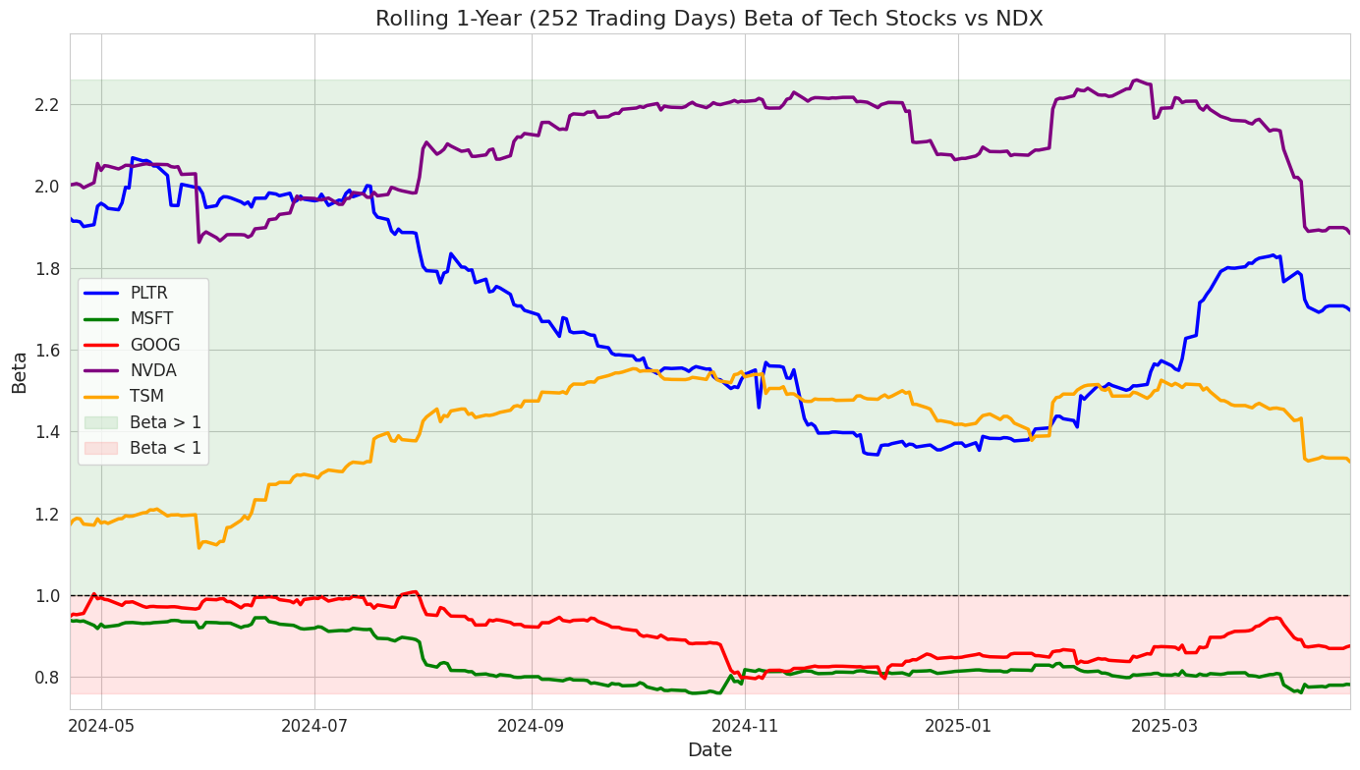
Beta Calculated Through Python
BETA OF AI TECH STOCKS
Python Calculations

Slide 9
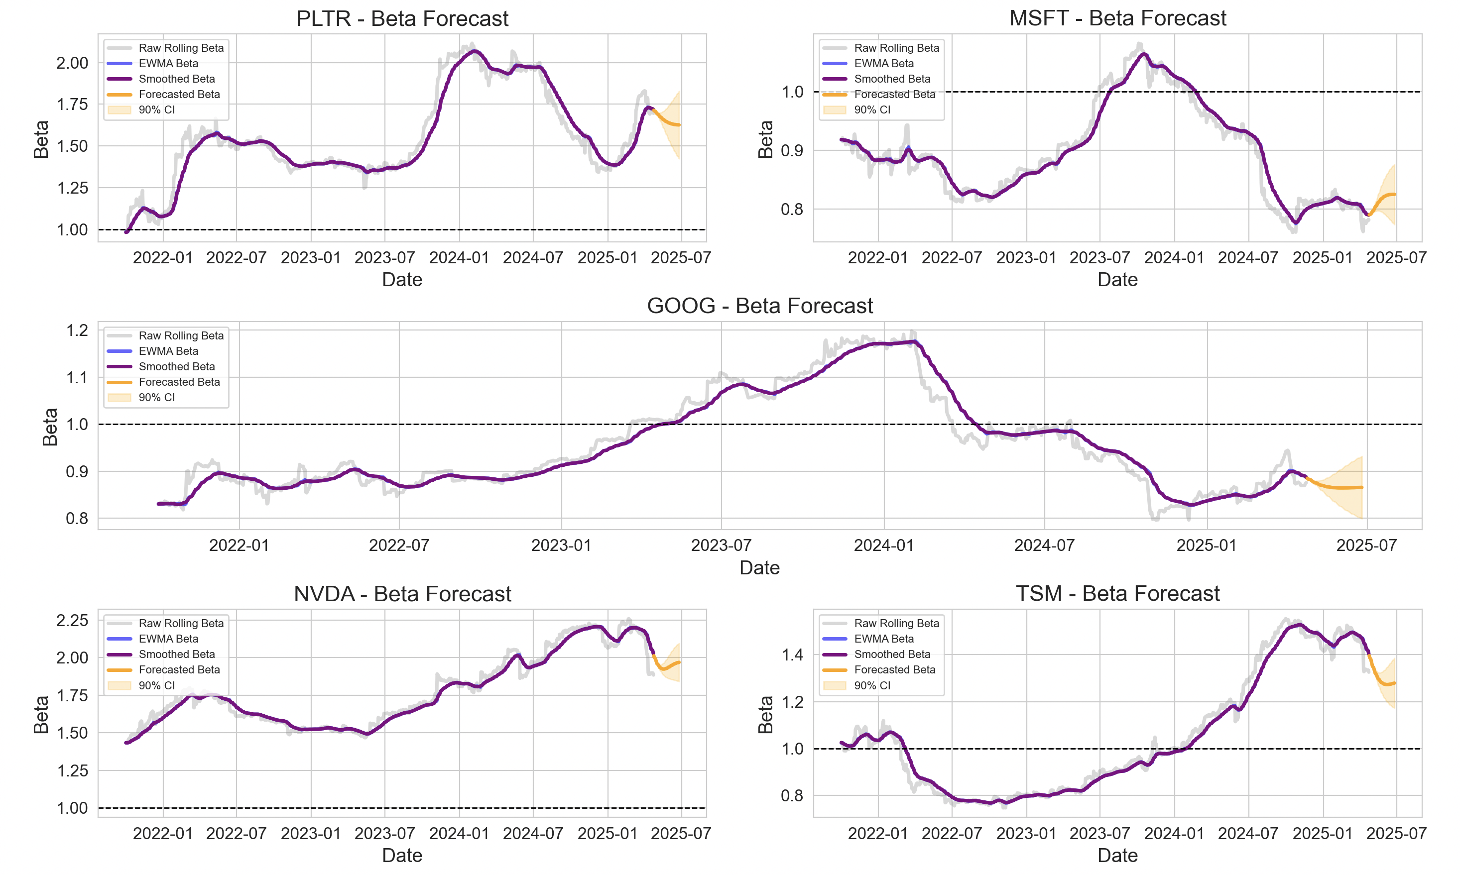
Beta Forecasting with ARIMA
BETA OF AI TECH STOCKS
ARIMA Model To Predict Beta

Slide 10
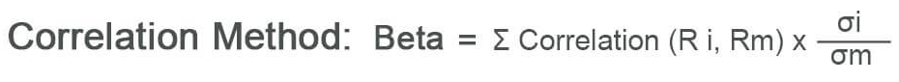
Beta – In Action
BETA OF AI TECH STOCKS
How its Used
Other Risk-Predictor Indicators
> 1
1
< -1
Another way we can utilize the beta is by pairing the beta with the correlation of the function, as this will allow us to better understand how effective the beta, and with it our forcast, will be, as well as telling us the direction of the stocks and index relationship.
What its Useful For
Everyday Use: Measurement of how volatile a stock is going to be in relation to the market. Every 1% move in the market = β% move in the market
Quant Algorithms: Measures the volatility of a stock versus the market index.
Beta Hedging: Aim to be beta neutral by buying stocks with a beta inverse of stock of comparison
With Alpha (α): alpha is the excess return of a stock or fund. Usually used with beta in CAPM
Confidence intervals can also help us better utilize the beta model as we can use these intervals to create more conservative models for beta hedging and quant algorithms.

Slide 11
Limitations and Challenges
BETA OF AI TECH STOCKS
Limitations
Challenges
The greatest limitation we faced is that there is no well-established market index exclusively devoted to AI
Another limitation we faced in this project is that some of the bigger players in this market, such as OpenAI, do not openly trade stocks in exchanges
One challenge we faced was that, as the AI tech stock field is relatively new, it is harder to define what the market for AI is, as this market is not as well established as other markets, such as the oil industry for example.
One challenge we faced was, when I was working on excel, was to compare the volatilities to each other to find the beta however, as I attempted to do this, I found that this was over complicating the problem, and would be harder and less precise as using the covariance over the variance to find the beta, resulting in me using the covariance and variance to find the data and not the volatility comparison system.

Slide 12
Conclusions
BETA OF AI TECH STOCKS
Overview of how our hypothesis supports a short-term investment of ai tech stocks because AI tech stocks happen to be more volatile and have an average value between 1.5 and 2.5
Our research supports the theory that the inherent volatility of AI tech with their high beta values suits them to short-term investment strategies. Beta mostly paired with models like CAPM and hedging options that can further tailor risk exposure. We found that while the volatility of the industry poses higher risk, it also offers the potential for short-term return, particularly with the ongoing fast development of the AI sector. Investors who understand how to work beta in their favor are better positioned to capitalize on short-term opportunity while minimizing downside risk.

Slide 13
References – Quick Links
BETA OF AI TECH STOCKS
https://www.businessinsider.nl/beta-can-help-you-determine-how-much-your-portfolio-will-swing-when-the-market-moves/
https://stats.stackexchange.com/questions/481277/is-beta-sometimes-bessel-corrected
https://scholarworks.sfasu.edu/etds/427/#:~:text=Statistical%20inference%20for%20the%20mean,recommendations%20on%20the%20best%20practice.
https://ebookscheaper.com/product/introduction-to-linear-regression-analysis-5th-edition-isbn-13-978-0470542811/?srsltid=AfmBOorXrgRN4jrqGFwkn9jBnnT8W--tLbxz_ffRfKpkFEbmJMezGeDe
https://www.investopedia.com/ask/answers/061715/what-are-differences-between-delta-hedging-and-beta-hedging.asp

